Slide 1
Continental HR Data Analytics:
Key Performance Indicators (KPI) Dashboard
Yijing An, Alireza Fatemi, Alexandra Nelson, Lina Taheri

Slide 2
What is KPI?
Organizations use Key Performance Indicators to evaluate their success at reaching targets. The role of the KPI is to provide awareness of how you’re progressing toward the company’s short-term and long-term goals.

Slide 3
HR KPIs
In this project HR KPIs are visualized in a dashboard.
Meaningful indicators for this dashboard:
Diversity, Gender, Salary Grades, etc.

Slide 4
KPI Dashboard Project goals
Create clear, effective, dynamic visualizations
Meet the needs of our users (Managers & Executives)
Create control and flexibility through filters
Aligning data with map to establish variations regionally

Slide 5
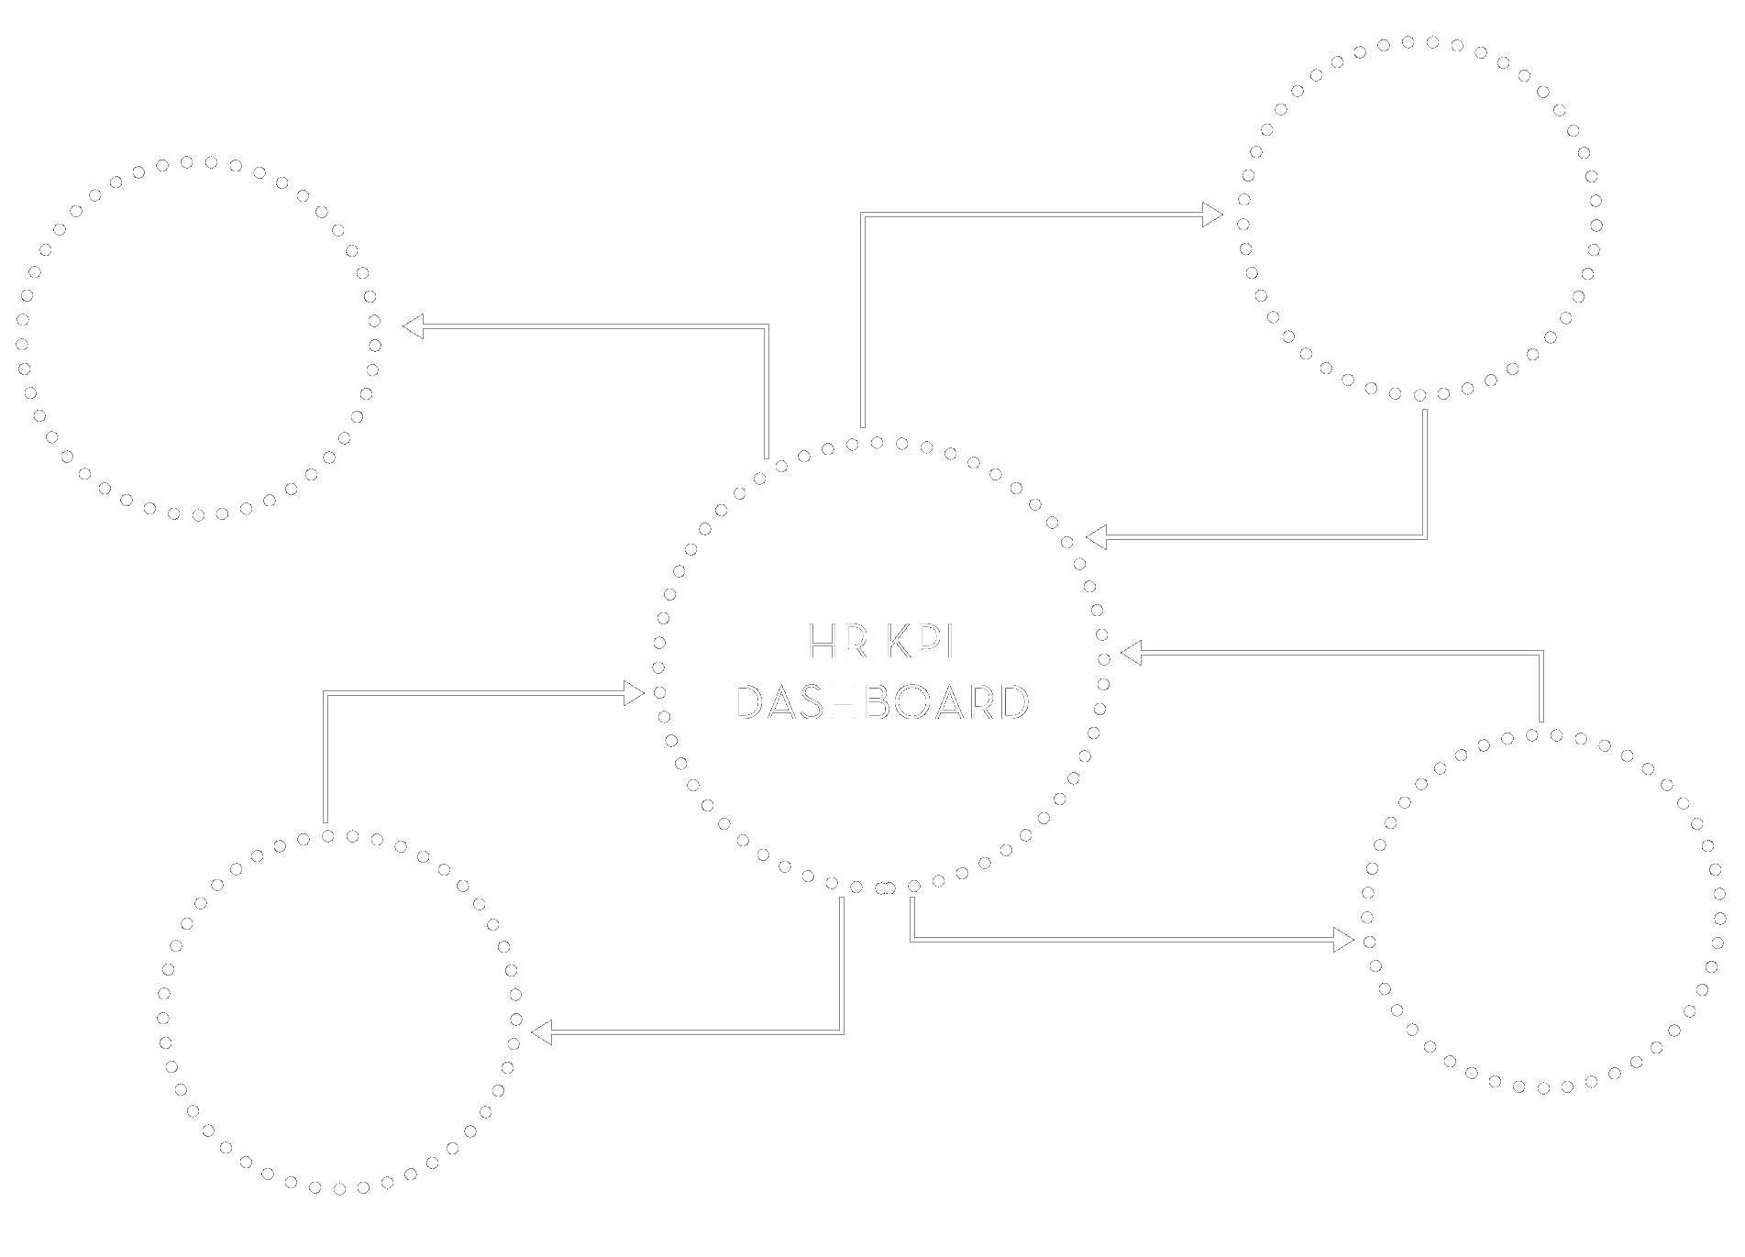
Who’s our user?
Executive
High Level Manager
Low Level Manager
IT/ Analyst

Slide 6




{ }
+
Data Server
Frontend

Slide 7
Status of our project

Slide 8
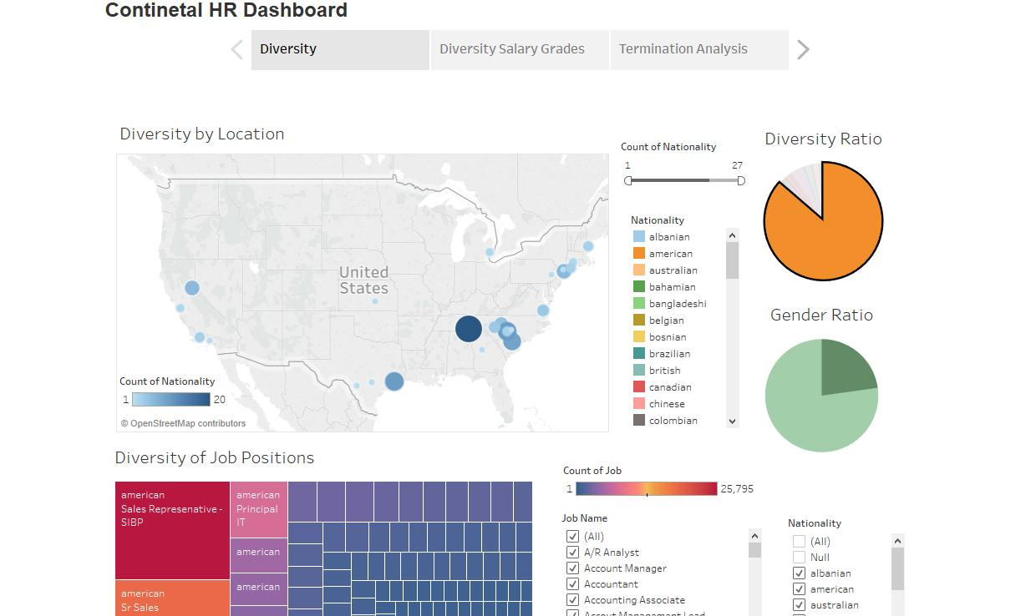

Slide 9
Demo

Slide 10
Challenges and Achievements

Slide 11
Achievements:
Challenges:
Successfully using features of Tableau for our project purpose
Improved visualizations based on product owner’s requirements feedback
Cleaned data set for our own purpose
Successfully created meaningful charts and diagrams
Had the best teamwork experience
Selecting the tools
Understanding and cleaning the data
Connecting correct data to Tableau
Limitation in working collaboratively on the same file

Slide 12
Sprints
Item Type | Sprint Number | Task Name | Duration | Start | Finish | Predecessors
Sprint | 1 | User Studies + Get access to the data | 10 days | Thu 1/25/18 | Wed 2/7/18
Sprint | 2 | Structure + Analyze the data | 3 days | Thu 2/8/18 | Mon 2/12/18 | 1
Sprint | 3 | Setup + Test Development Platform | 10 days | Thu 2/22/18 | Wed 3/7/18 | 10
Sprint | 4 | Design + Develop | 10 days | Thu 3/8/18 | Thu 3/22/18 | 20
Sprint | 5 | Develop the Dashboard Front End | 10 days | Thu 3/22/18 | Thu 4/5/18 | 29
Sprint | 6 | Develop the dashboard | 10 days | Thu 4/5/18 | Thu 4/19/18 | 38
Sprint | 7 | Final Test and Presentation | 8 days | Thu 4/19/18 | Thu 5/3/18 | 52

Slide 13
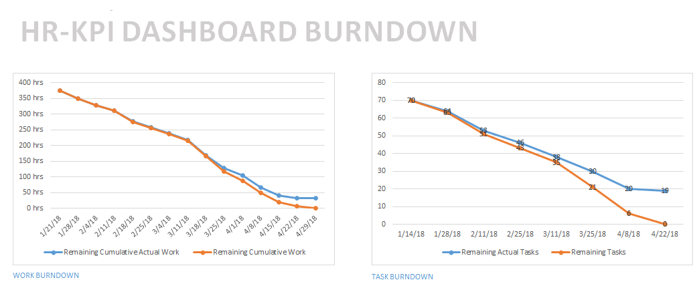
Burndown Chart

Slide 14
Thank you!

